Slide 1



Elastic Data Binning for Transient Pattern Analysis in Time-Domain Astrophysics
Thanapol Phungtua-eng¹, Yoshitaka Yamamoto¹ and Shigeyuki Sako²
1. Department of Informatics, Shizuoka University, Japan
2. Institute of Astronomy, University of Tokyo, Japan
The 38th ACM/SIGAPP Symposium On Applied Computing Tallinn Estonia March 27 - March 31, 2023

Slide 2


Outline
Introduction
Background of time-domain astrophysics analysis
Our motivation of this study
Elastic data binning (EBinning)
Experimental results and Conclusions

Slide 3
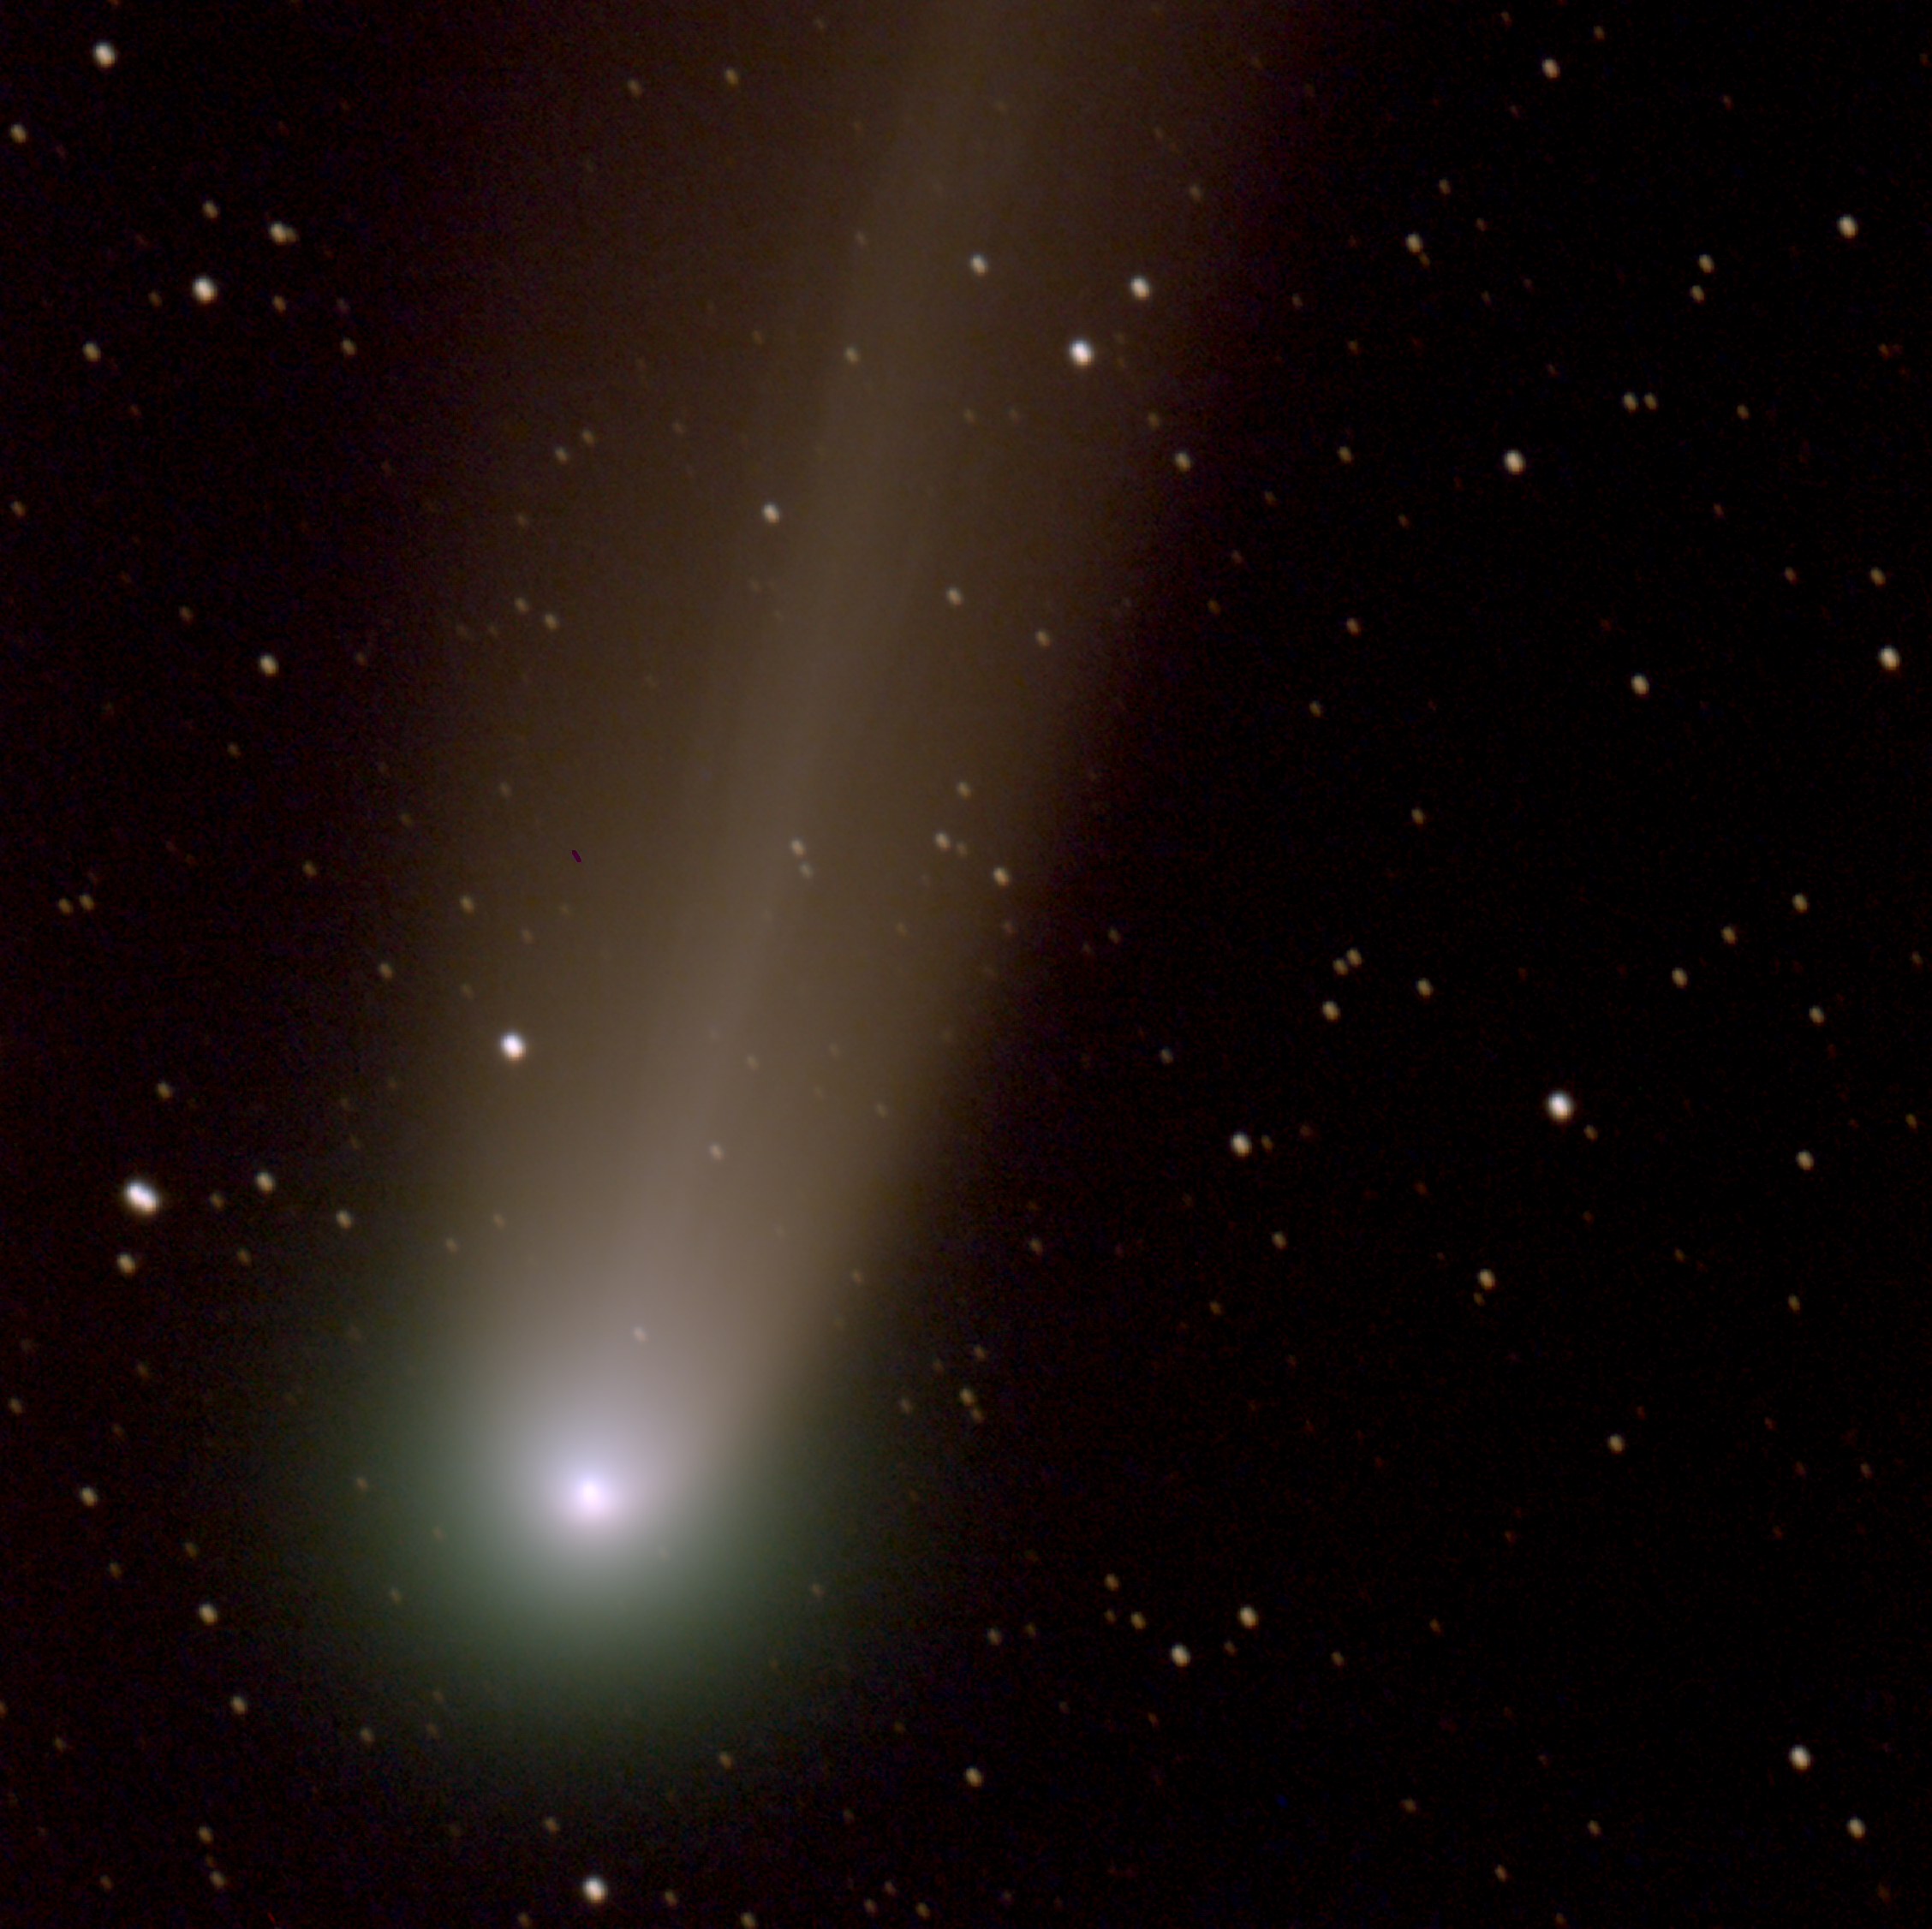
Introduction
Fig : Comet Lovejoy (2013/12/16) from Kiso Schmidt telescope

Slide 4
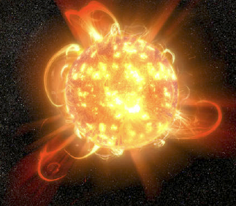

What is time-domain astrophysics analysis (TDAA)?
TDAA is a powerful method for studying astronomical events that vary over time.
Example of astronomical events
Rapidly rotating white dwarf
Very fast flaring
Blazar
Etc.
In TDAA, we analyze light curves to study how the brightness change over the time of astronomical events.
Figure ref: M. Aizawa, “HeSO survey: search for sub-min variability of white dwarfs and M dwarfs”, Kiso Schmidt Symposium 2021.

Slide 5
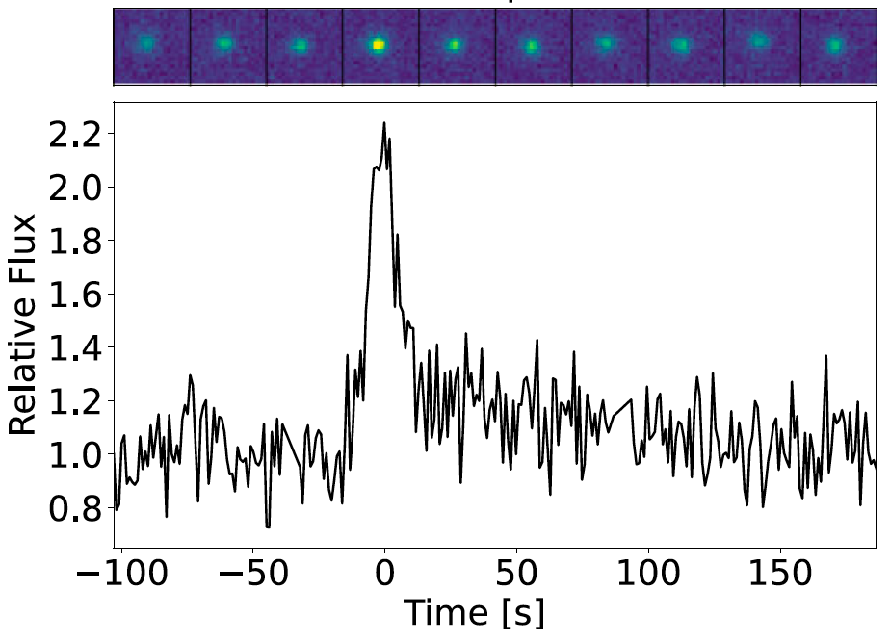
What is Light curves (LCs) for TDAA?
LCs are plots of an object's brightness over time.
Advantages of using LCs include:
Easy trend identification and analysis from visual observation
Significant reduction in storage space (e.g., from 3TB to 100GB)
LCs are widely used to study short-lived astronomical events in TDAA.
Comparison between video and LC*
* M. Aizawa et al., Fast optical flares from M dwarfs detected by a one-second-cadence survey with Tomo-e Gozen, Publications of the Astronomical Society of Japan, Volume 74, Issue 5, October 2022, Pages 1069–1094

Slide 6
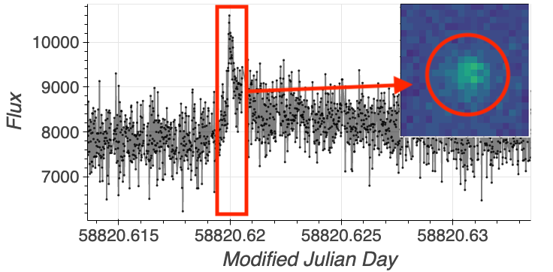
What is the transient pattern?
The short-lived events in LCs know as transient pattern.
Transient pattern refers to a time-series signal in LCs that is associated with a transient event.
Transient events are short-term events that suddenly and intensively happen in an astronomical object.
Our domain lies in transient patterns analysis using LCs in the astrophysics field.
Transient pattern
Example of transient pattern

Slide 7
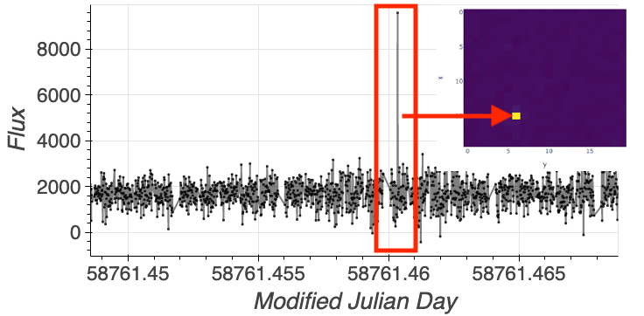
Transient pattern vs. outlier in LCs
Note we removed video files in this slide
Transient patterns are associated with actual astronomical events.
Outliers are typically caused by noise or measurement errors.
The outliers are not astronomical events.
Outlier
20-seconds video of flare with 50% slow motion
20-seconds video of outlier with 50% slow motion

Slide 8
What is techinque for transient pattern analysis?
Transient pattern analysis with LCs typically employs data binning*.
Data binning also known as Piecewise Aggregate Approximation (PAA)⁺.
Data binning makes a new representation of the time-series using bins, each of which stores statistical features.
Example of statistical features : mean, variance, median
Advantages of data binning :
Extracts relevant characteristics of transient patterns
Reduces noise
Has low time complexity
* Data binning is included in the Astropy library.
⁺ E. Keogh, et al. Dimensionality Reduction for Fast Similarity Search in Large Time Series Databases. Knowledge and Information Systems 3, 2001.

Slide 9
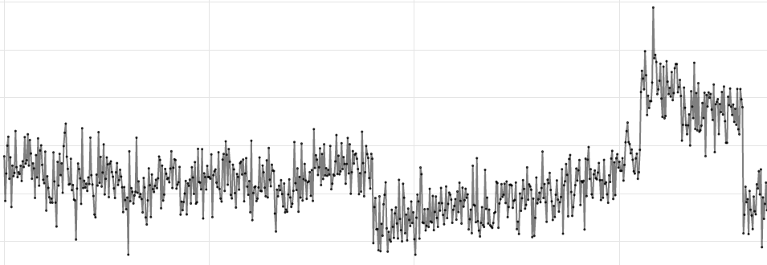
Traditional data binning
Input : Given LC and bin size.
Step 1: LC is divided into subsequences and stored each subsequence in a bin.

Slide 10
Traditional data binning
Step 2 : Represent each bin with its bin size (n) and mean (μ).
Mean of each bin is statistical features of subsequence.
(n₁,μ₁)
(n₂,μ₂)
(n_{i},μ_{i})

Slide 11
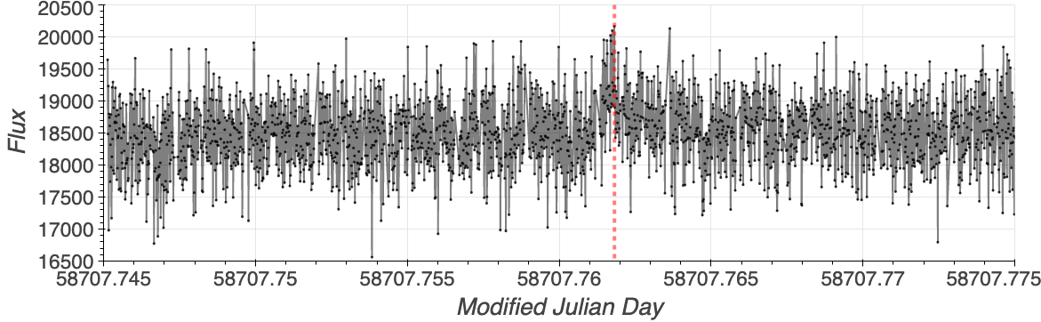
Limitation of traditional data binning
An input parameter that produces a new representation by data binning is required.
It is important to avoid using arbitrary bin sizes when setting up the representation method.
This can affect the accuracy of the results.
Real flare
Input LC

Slide 12
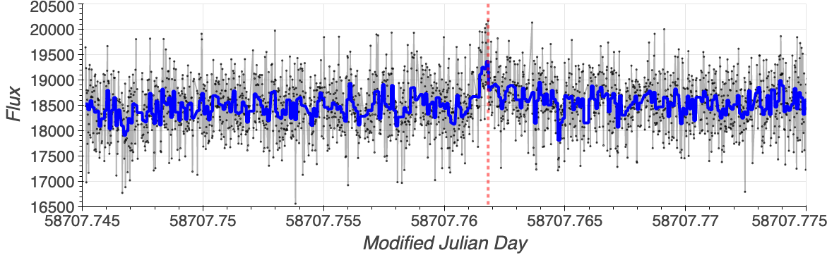
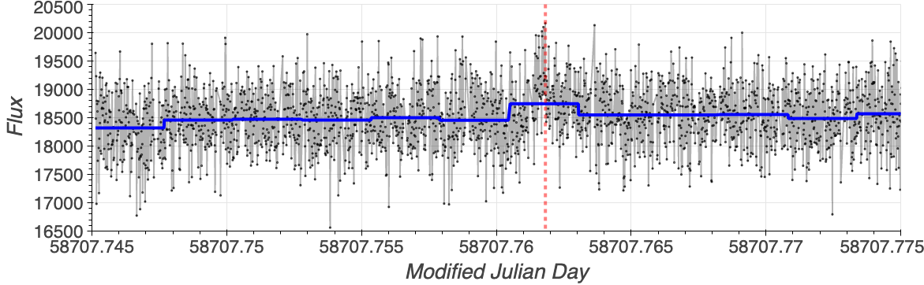
Influnce of bin size problem
Original LC
Real flare
Bin size is too small
Bin size is too large
Too noise
Suddenly change is unclear

Slide 13
Our motivation of this study
Goals:
Develop a method for automatic bin size adjustment to balance quality and noise degradation of new representation.
Analyze transient patterns missed by standard techniques.
Approach:
Utilize LCs as input time series data without requiring user-defined bin sizes by assumptions.
Eliminate the need for a training model or process.

Slide 14

Elastic data binning (EBinning)
Fig : Orion Nebula (2017) from Kiso Schmidt telescope

Slide 15
Elastic data binning (EBinning)
EBinning automatically adjusts the size of each bin in the window for transient pattern analysis with LCs.
Ebinning has three main functions:
Initialization function
Mergeability score computation function
Merging function

Slide 16
Initialization function
The initialization function creates an empty buffer and adds subsequences to it.
Once the buffer is full, it is summarized into bins and added to the window.
Window
Input
Buffer

Slide 17
Initialization function
The initialization function creates an empty buffer and adds subsequences to it.
Once the buffer is full, it is summarized into bins and added to the window.
Window
Input
Summarize into bin and add into window
Buffer

Slide 18
Initialization function
The initialization function creates an empty buffer and adds subsequences to it.
Once the buffer is full, it is summarized into bins and added to the window.
Window
Input
Bin₁
Summarize into bin and add into window
Buffer

Slide 19
Initialization function
Initialization function creates an empty buffer and adds subsequences to it.
Once the buffer is full, it is summarized into bins and added to the window.
Window
Input
Bin₁
Bin₂
Summarize into bin and add into window
Buffer

Slide 20
Mergeability score computation
We compute mergeability scores (k) between two neighboring bins in the window.
Closest to zero: neighboring bins are the same feature.
Farthest from zero: neighboring bins are not the same feature.
ScoreProfile is a data structure that stores the mergeability scores of each pair of neighboring bins.
It has no prior bin because it is the first bin in the window.
We set the mergeability score to infinity.
Bin₁
Bin₂
∞
Window
ScoreProfile

Slide 21
Mergeability score computation
We compute mergeability scores (k) between two neighboring bins in the window.
Closest to zero: neighboring bins are the same feature.
Farthest from zero: neighboring bins are not the same feature.
ScoreProfile is a data structure that stores the mergeability scores of each pair of neighboring bins.
Compute
mergeability score
Input result into Score profile
Bin₁
Bin₂
∞
2
Window
ScoreProfile

Slide 22
Mergeability score computation
Add bins and compute mergeability score until the window is full.
Window
Input
Bin₁
Bin₂
Bin₃
…
Bin_{n}
∞
2
5
…
9
Buffer
ScoreProfile

Slide 23
Mergeability score computation
Add bins and compute mergeability score until the window is full.
Then select the index with the minimum mergeability score.
Window
Input
Bin₁
Bin₂
Bin₃
…
Bin_{n}
∞
2
5
…
9
Buffer
ScoreProfile

Slide 24
Merging function
We merge bins with minimum mergeability scores when the window is full.
Merge two neighboring bins
Bin₁
Bin₂
Bin₃
…
Bin_{n}
∞
2
5
…
9
Window
Minimum mergeability scores
ScoreProfile

Slide 25
Merging function
We merge bins with minimum mergeability scores when the window is full.
Do the initialization function until the end of input.
After merging
Bin₁
Bin₂
…
Bin_{n-1}
∞
4
…
9
Window
Recompute
ScoreProfile

Slide 26
Two variants of EBinning
Mean-EBinning:
It uses statistical tests to determine mergeability scores based on the distribution of two neighboring bins.
Statistical features: mean value (μ) and the range of subsequence [a,b]
Linear-Ebinning:
It uses statistical tests to determine mergeability scores based on the trend of two neighboring bins.
Statistical features: intercept (⍺) and slope (β) of linear regression
(n, μ, a, b)
(n, ⍺, β)
Mean-EBinning
Linear-EBinning

Slide 27
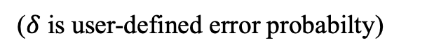
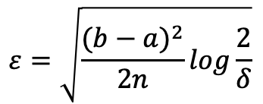
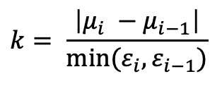
Mergeability scores of Mean-EBinning
Hoeffding’s inequality helps identify mergeable bins based on their mean values' boundaries (Ɛ).
Hoeffding’s inequality provides the probability of deviation of each bin.
Thereafter, we test two boundaries for distributed equality.
$$ε=\sqrt{\frac{{(b−a)}^{2}}{2n}log\frac{2}{δ}}$$
($δ$ is user-defined error probabilty)
μ_{i}
Ɛ_{i}
$$k= \frac{\left|μ_{i} −μ_{i−1}\right|}{min⁡(ε_{i},ε_{i−1})}$$
Ɛ_{i-1}
μ_{i-1}
Bin_{i-1}
Bin_{i}
Check whether two boundaries belong to the same distribution or not.

Slide 28
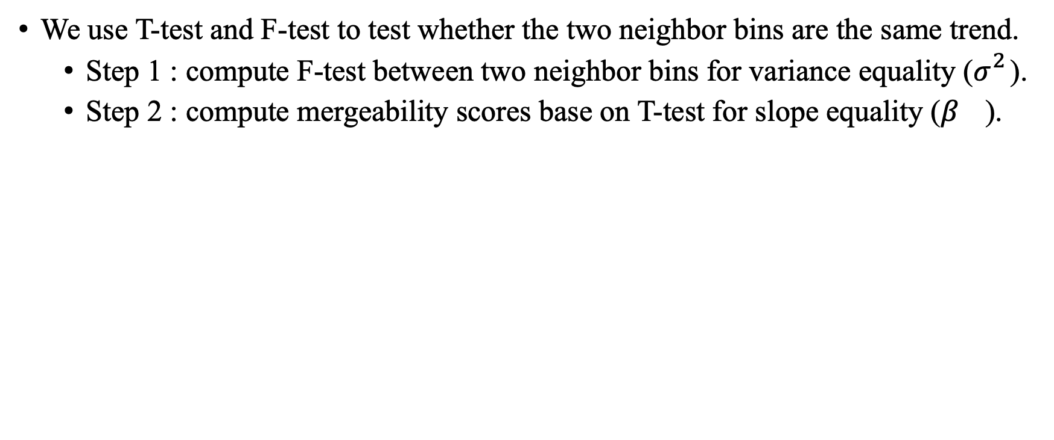
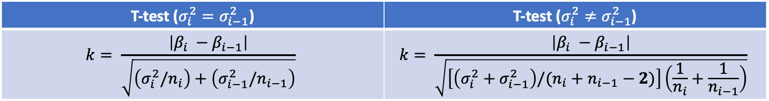
Mergeability scores of Linear-EBinning
We use T-test and F-test to test whether the two neighbor bins are the same trend.
Step 1 : compute F-test between two neighbor bins for variance equality ($σ_{}^{2}$).
Step 2 : compute mergeability scores base on T-test for slope equality ($β_{}$).
When two neighbor bins are same variance.
When two neighbor bins are not same variance.
Bin_{i-1}
Bin_{i}
T-test ($σ_{i}^{2}=σ_{i−1}^{2}$) | T-test ($σ_{i}^{2}≠σ_{i−1}^{2}$)
$$k= \frac{\left|β_{i} −β_{i−1}\right|}{\sqrt{\left(σ_{i}^{2}/n_{i}\right)+\left(σ_{i−1}^{2}/n_{i−1}\right)}}$$ | $$k= \frac{\left|β_{i} −β_{i−1}\right|}{\sqrt{\left[\left(σ_{i}^{2}+σ_{i−1}^{2}\right)/(n_{i}+n_{i−1}−2)\right]\left(\frac{1}{n_{i}}+\frac{1}{n_{i−1}}\right)}}$$
* B. L. Welch. 1938. The Significance of the Difference Between Two Means when the Population Variances are Unequal. Biometrika 29, 3/4 (1938), 350–362.

Slide 29
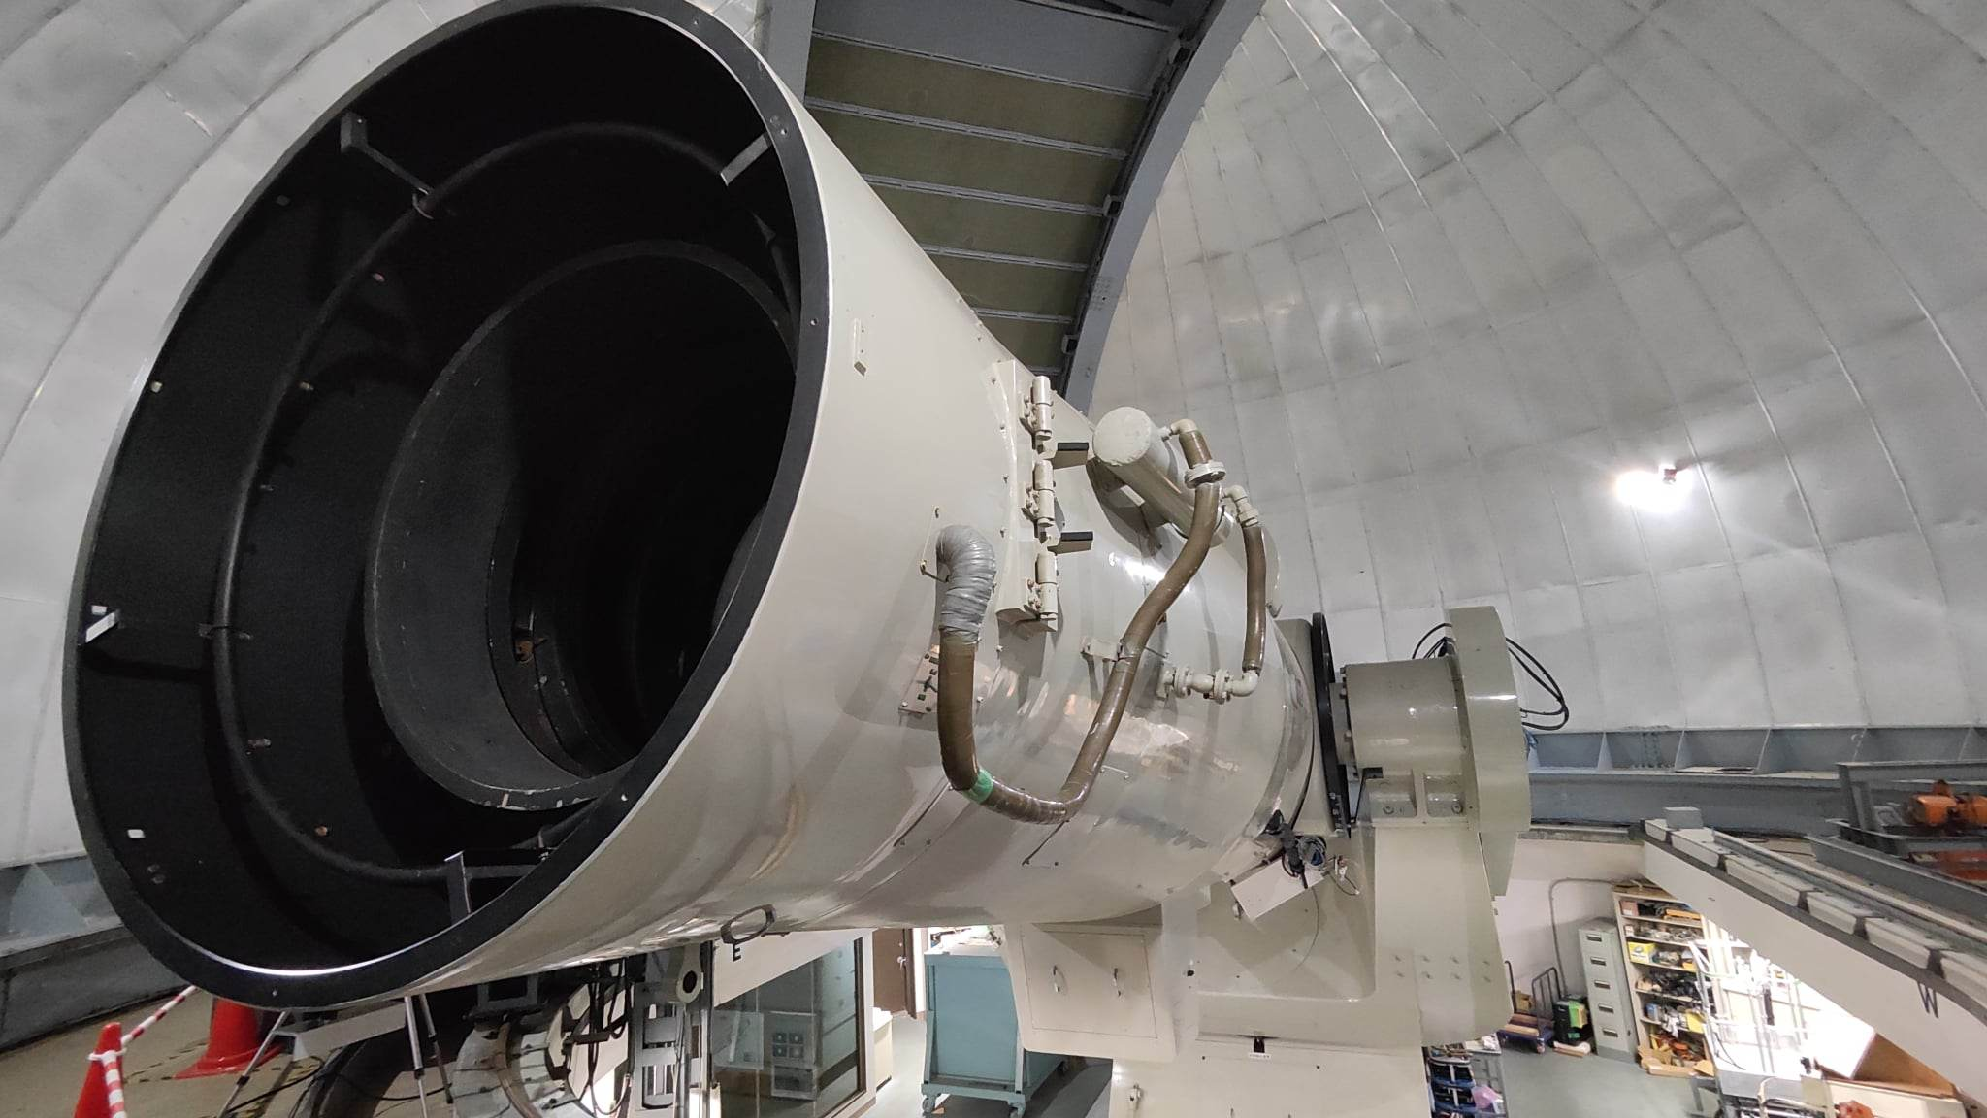
Experimental results & conclusions
Fig : 105cm Schmidt telescope at Kiso Observatory

Slide 30


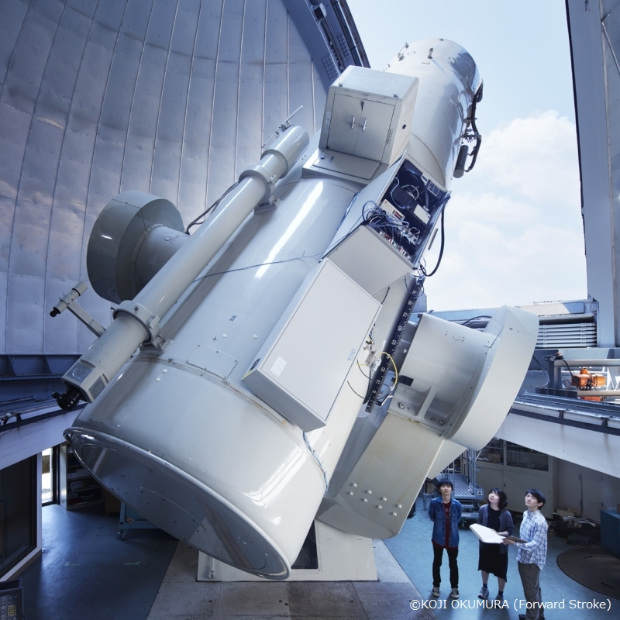
Observational data
Our dataset was provided from Tomo-e Gozen project* from Kiso Schmidt telescope.
Characteristics of LCs:
Stable behavior
Unstable behavior
Outlier point
Gradual change
Kiso Schmidt telescope*
* For more detail, visit https://tomoe.mtk.ioa.s.u-tokyo.ac.jp/

Slide 31
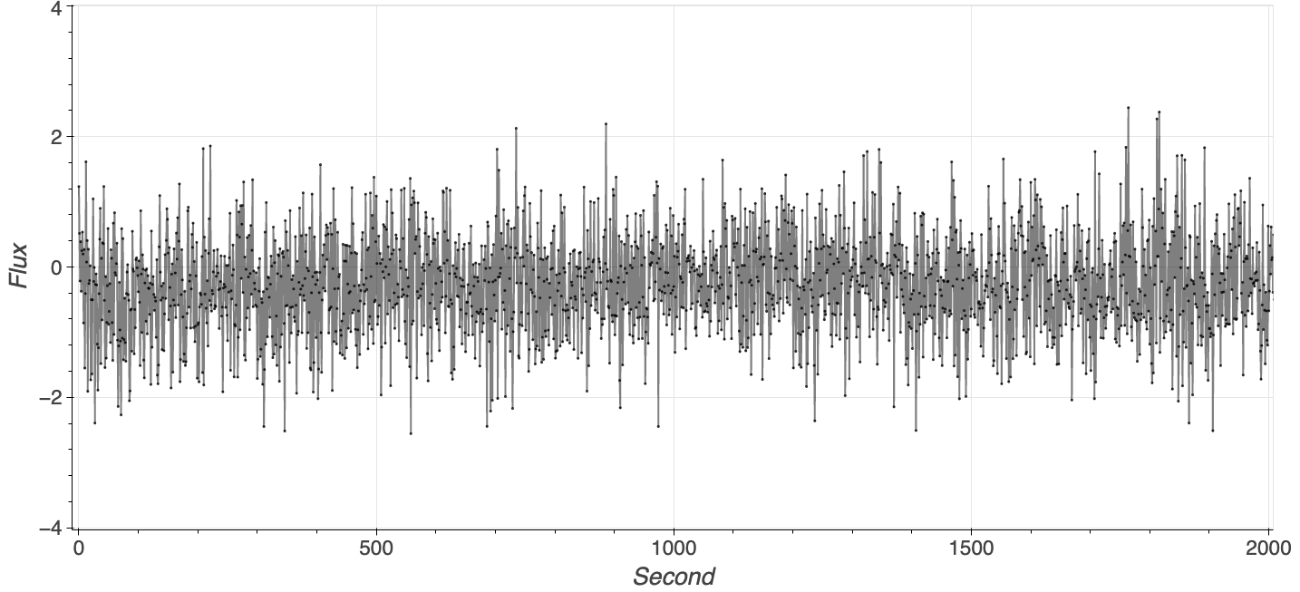
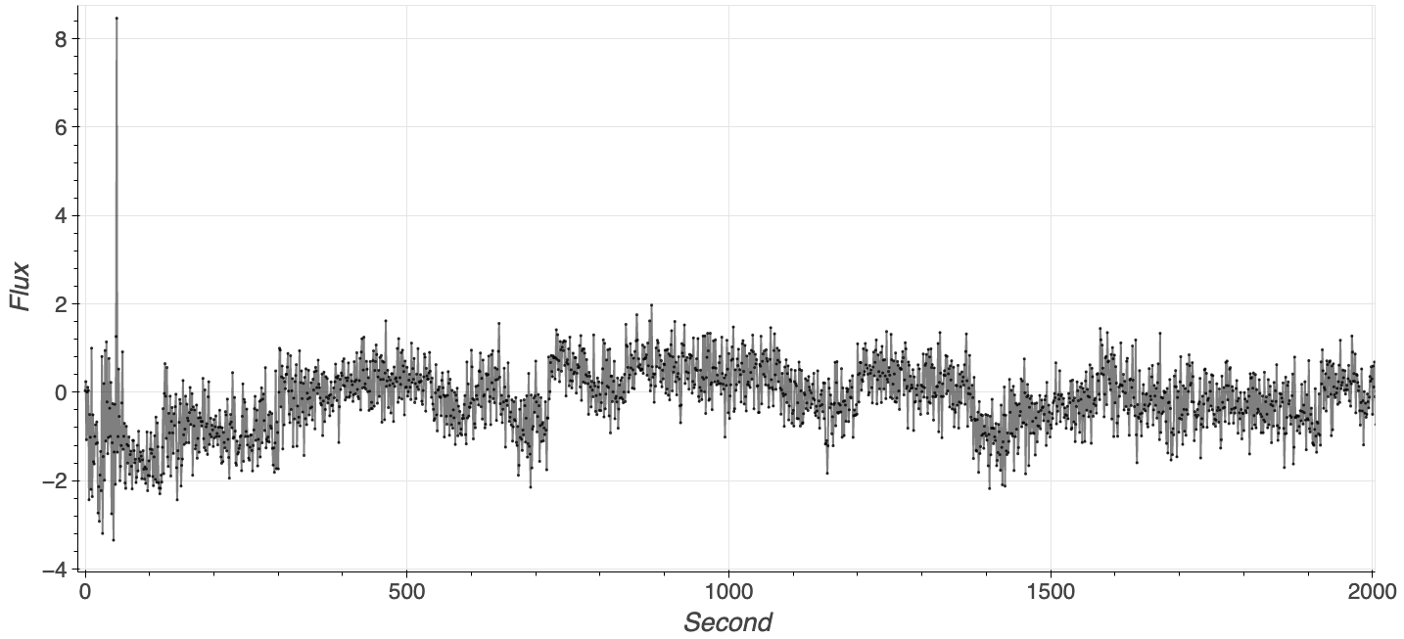
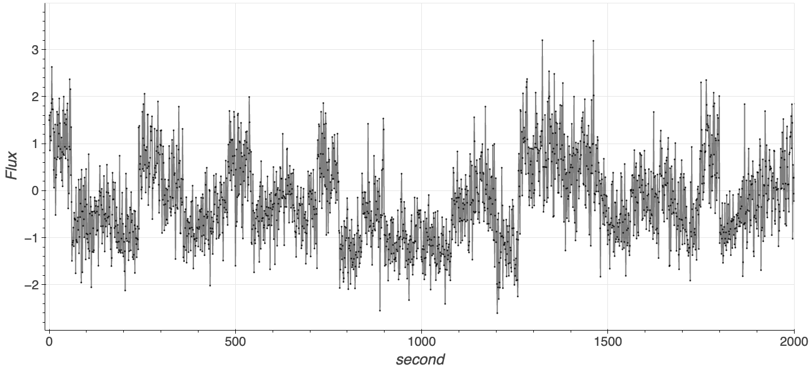
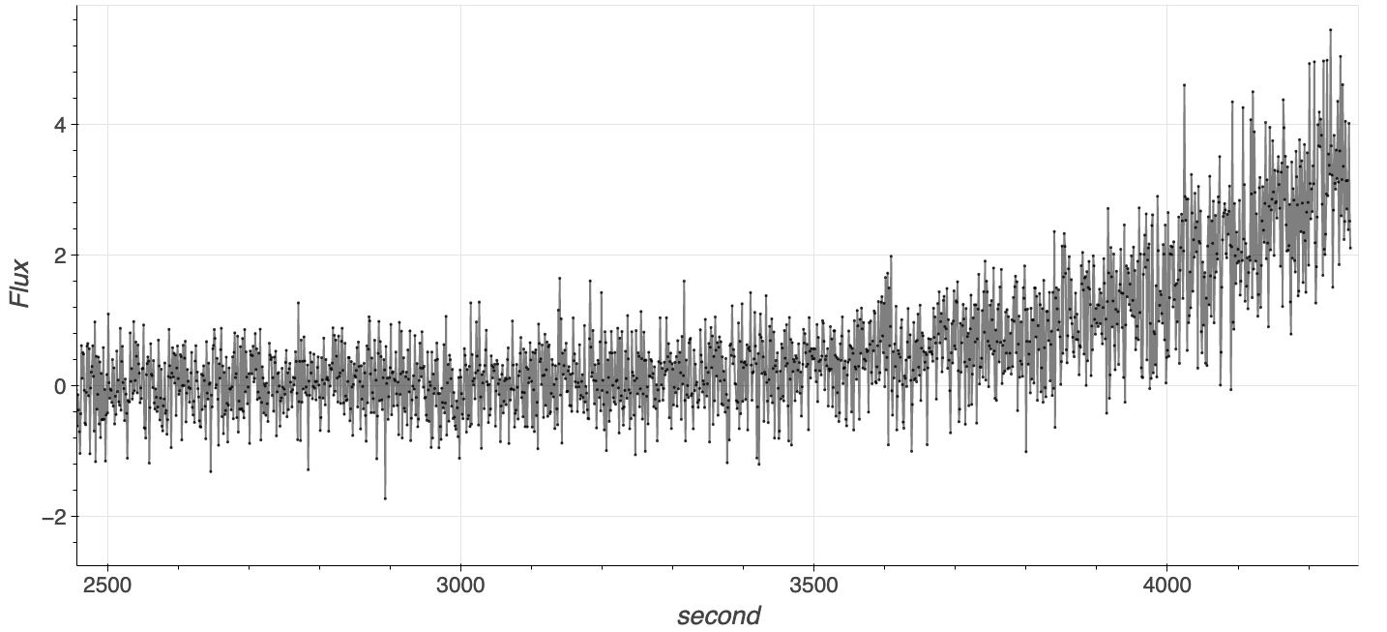
Characteristics of LCs
Stable behavior
Outlier point
Unstable behavior
Gradual change

Slide 32
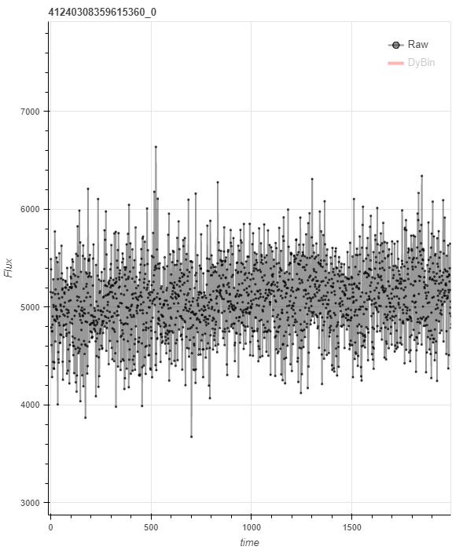
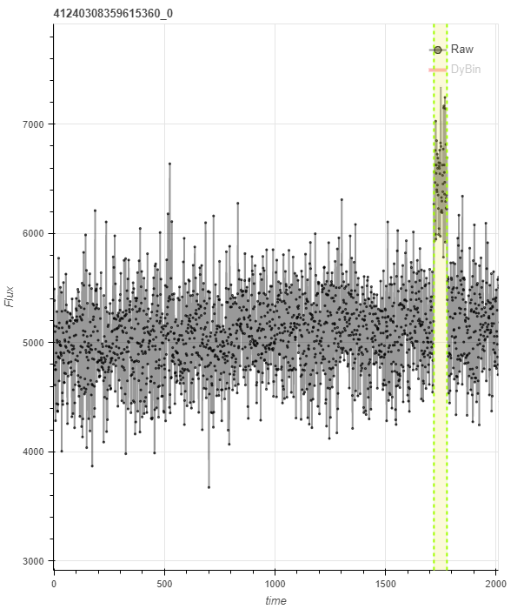
Artifact transient pattern injection
One artifact transient pattern was injected for each LC in the first evaluation.
All of them were confirmed by an astronomer to be non-real.
Original LC
After transient pattern injection

Slide 33
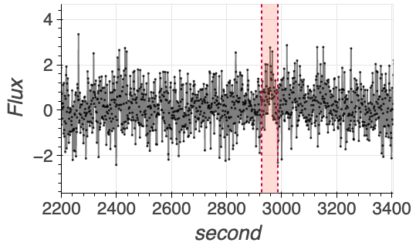
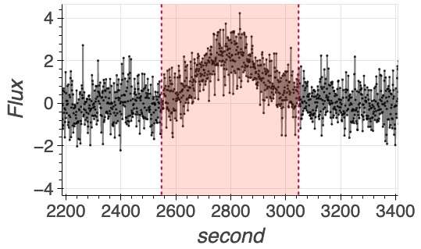
Artifact transient pattern injection (Cont.)
Lowest power and shortest duration
Highest power and longest duration

Slide 34
Experiments
We evaluated with three objectives:
Transient pattern capturing quality
Representation quality
Transient pattern detection
Alternative algorithms:
Piecewise Aggregate Approximation (PAA)¹
Symbolic Aggregate approXimation (SAX)² and 1D-SAX³
Matrix profile⁴
1 E. Keogh, et al. Dimensionality Reduction for Fast Similarity Search in Large Time Series Databases. Knowledge and Information Systems 3, 2001.
2 J. Lin, et al. Experiencing SAX: a novel symbolic representation of time series. Data Mining and Knowledge Discovery, 2007. vol. 15
3 S. Malinowski, et al. 1d-SAX: a Novel Symbolic Representation for Time Series. IDA 2013
4 C. M. Yeh et al. Matrix Profile I: All Pairs Similarity Joins for Time Series: A Unifying View That Includes Motifs, Discords and Shapelets ICDM 2016.

Slide 35
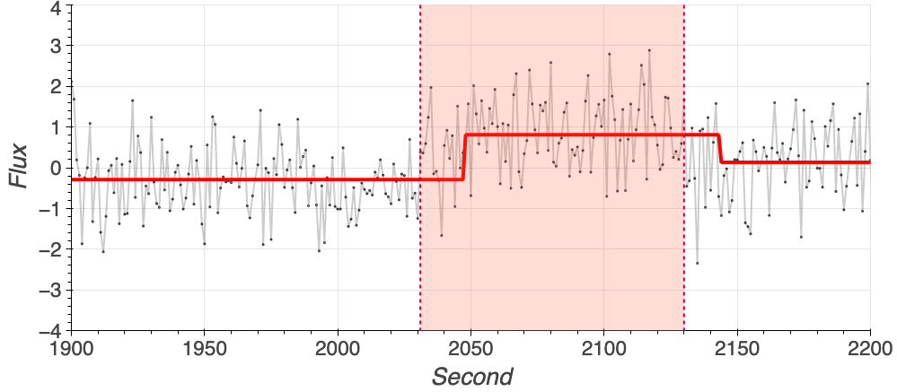
Transient pattern capturing quality
Objective: How do bins appropriately capture the transient pattern?
Indicator: intersection over union (IOU) for the overlap measurement between bin and transient pattern.
Red highlight is interval of transient pattern occurring.
IOU close to one means a bin properly covers the transient pattern.
IOU ≈ 0.84
Bin
Good scenario (High IOU)

Slide 36
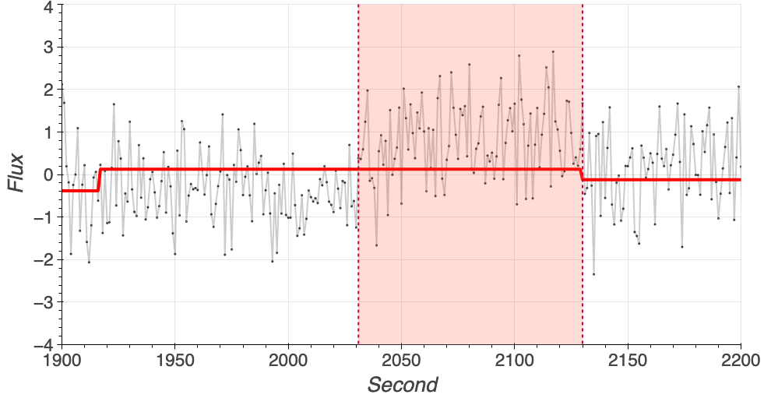
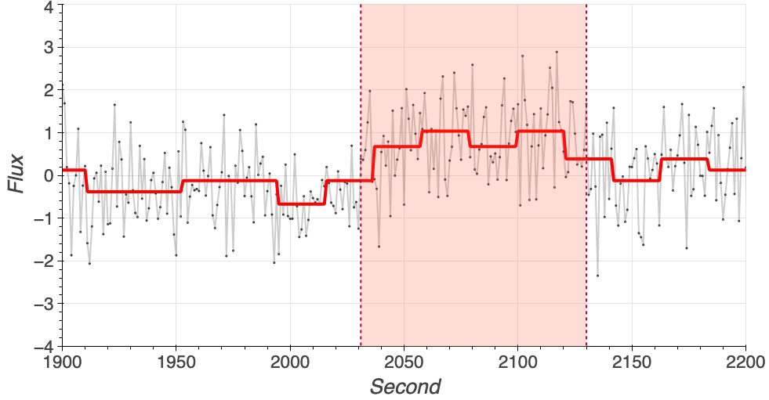
Transient pattern capturing quality (Cont.)
If the bin size is not suitable for the transient pattern, IOU will decrease.
If there are many bins when transient pattern occurs, we choose the one with the highest IOU value.
IOU ≈ 0.21
IOU ≈ 0.46
Bin
Bin
Bin size is large
Bin size is small

Slide 37
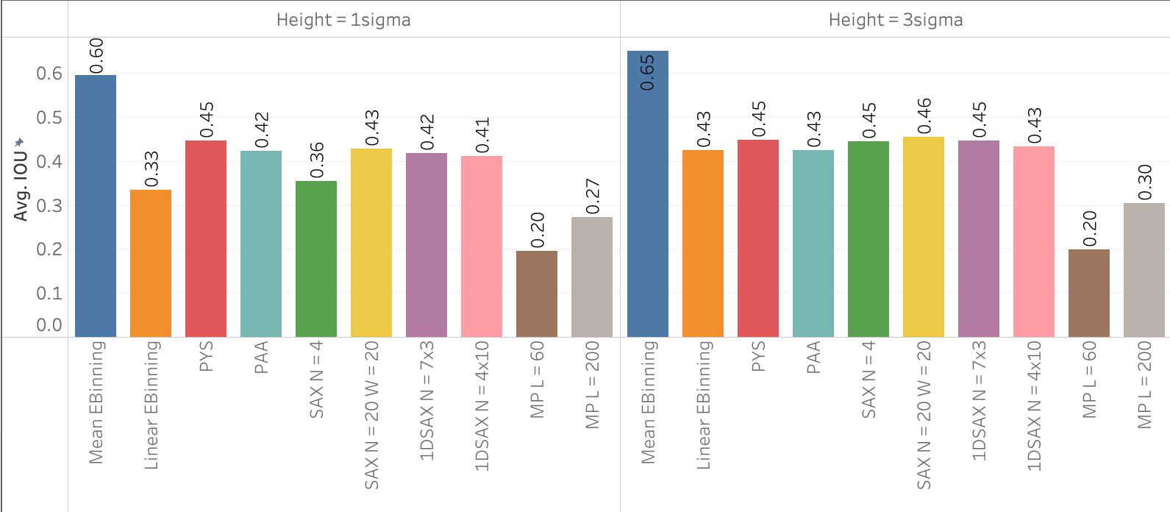
Transient pattern capturing quality (Cont.)
Mean-EBinning is suitable for transient pattern capturing.
Linear-EBinning cannot provide good results for transient pattern capturing.

Slide 38
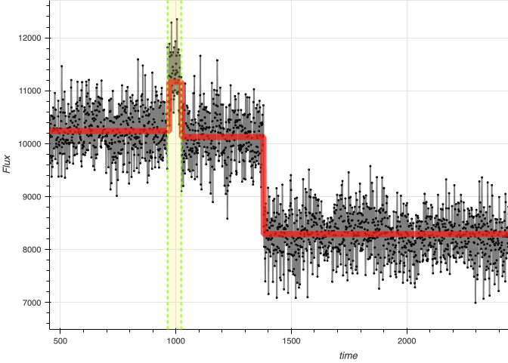
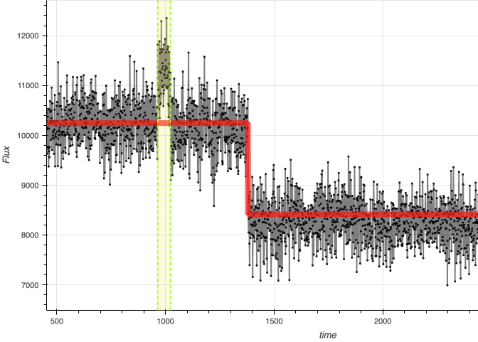
Representation quality
Objective: How is the representation different from the original LC?
Indicator: Euclidean distance between LC and representation.
Euclidean distance of LHS < Euclidean distance of RHS
Good scenario
Bad scenario
Cannot represent suddenly change

Slide 39
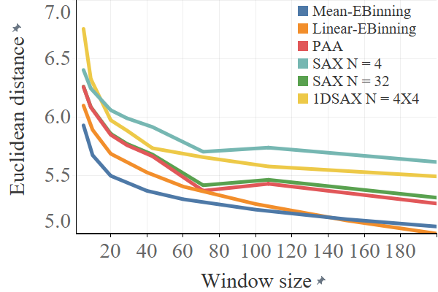
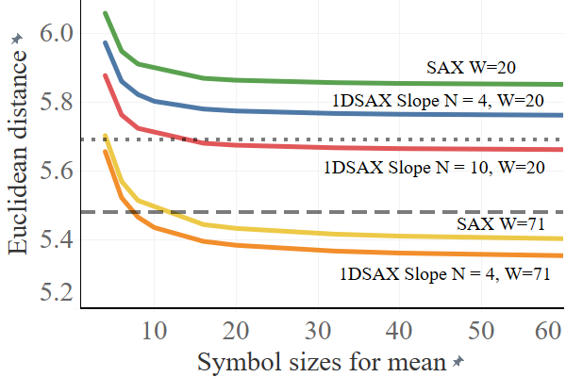
Representation quality (Cont.)
Mean-EBinning achieved better results than other algorithms with the same window size.
The Euclidean distance can be adjusted by inputting suitable parameters.
Linear-EBinning (W = 20)
Mean-EBinning (W = 20)
Various window size
Various symbols size for means

Slide 40
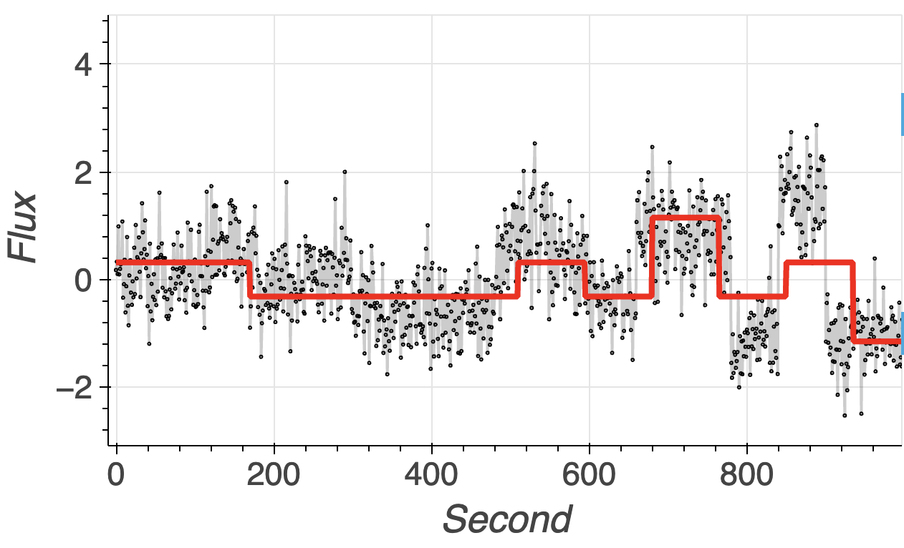
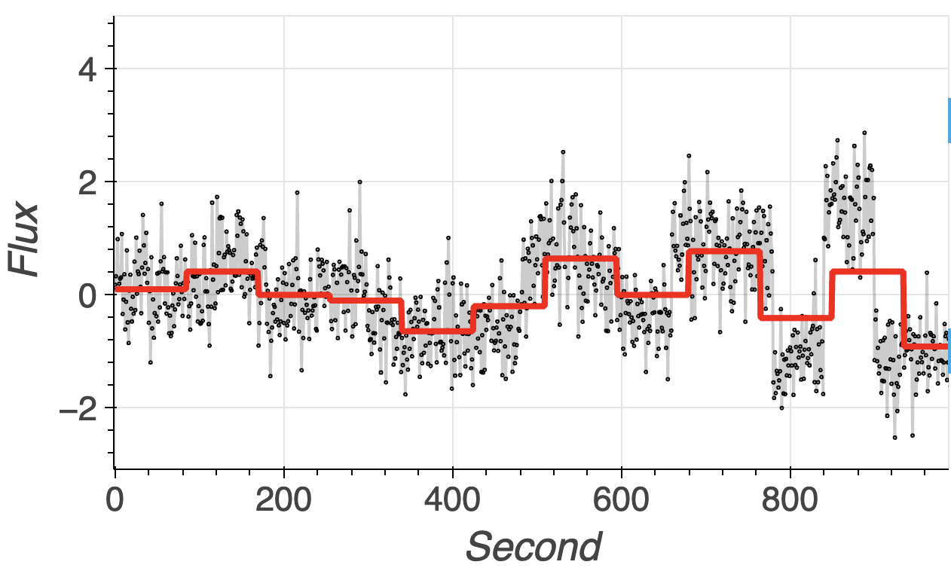
Representation quality (Cont.)
Low Euclidean distance may not capture transient pattern.
Because IOU of SAX is lower than our proposed method.
Euclidean distance is lower than LHS.
Mean symbols = 4
Mean symbols = 20

Slide 41
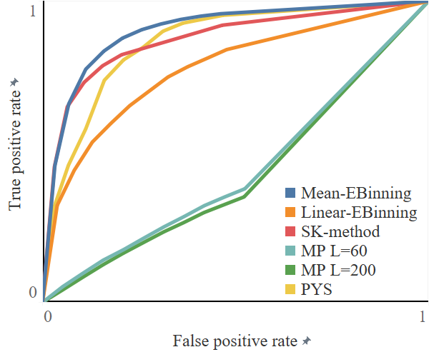
Transient pattern detection
Objective:
Which method has a high accuracy rate in detecting transient patterns?
Indicator:
True positive and false positive rates, and plotting the receiver operating characteristic (ROC) curve.
Result:
Mean-Ebinning outperformed alternative algorithms.
SK-method with PAA has high performance with sutiable bin size.

Slide 42
Evaluation conclusion
Alternative algorithms (PAA, SAX, 1D-SAX, MP) have limitations and require the user to define bin/symbol/subsequence sizes.
Our algorithm overcomes these limitations by allowing for a more flexible input.
Comparing alternative algorithms reveals strengths and weaknesses.

Slide 43
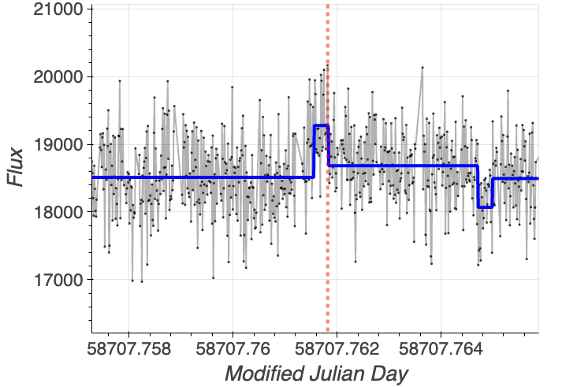
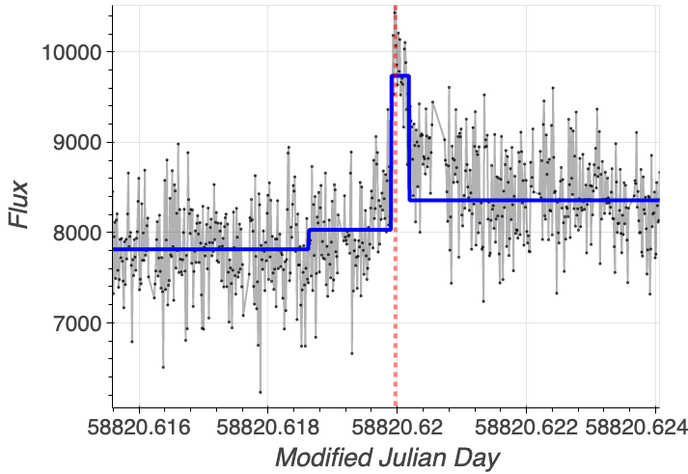
Real-world flare evaluation
We evaluate LCs that contain real flares from M dwarfs* to represent the features of real flares.
The red line indicates the peak of the flare confirmed by astronomers.
* M. Aizawa et al., Fast optical flares from M dwarfs detected by a one-second-cadence survey with Tomo-e Gozen, Publications of the Astronomical Society of Japan, Volume 74, Issue 5, October 2022, Pages 1069–1094

Slide 44
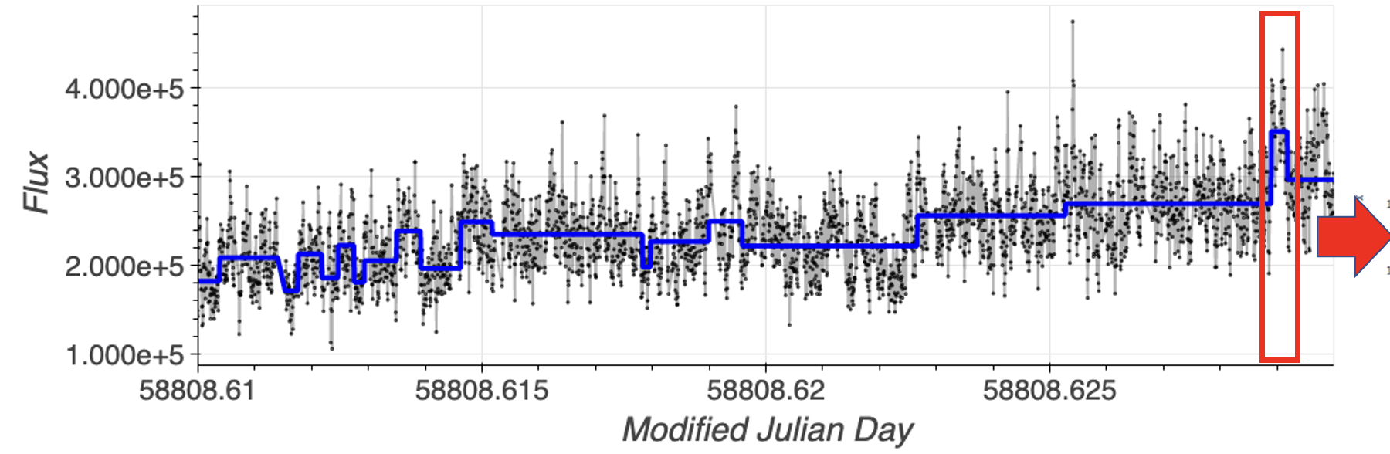
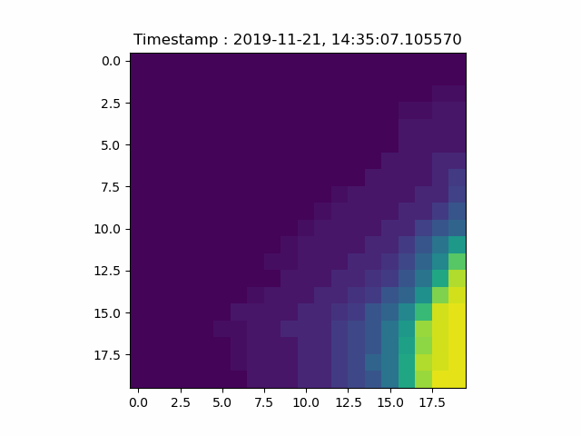
Real-world flare evaluation (Cont.)
We found the false positive case using EBinning.
The cause of the false positive was due to the video containing two stars.
In the real world, astronomers would confirm false positive case by conducting additional video checks after analyzing LC.
Main star
Nearby star

Slide 45
Conclusion
Bin sizes can freely parameter without cornering significant differences results.
Relevant characteristics of transient patterns can be extracted using EBinning.
Further plan
Investigating ways to address simultaneous event detection and video containing tow stars.
Applying with real-world environments.
exploring EBinning application in other domains.

Slide 46
Thank you for attention

Slide 47


Useful link
Dataset/ supplementary material/ source code:
Tomo-e Gozen project:
https://sites.google.com/view/elasticdatabinning/
https://tomoe.mtk.ioa.s.u-tokyo.ac.jp/
(Google : Tomo-e Gozen Project Kiso)

